Slide 1
DOD FARM WOODLAND CREATION LANDSCAPE ANALYSIS 3D Landscape Perspectives and Design Visualisations
Using Map Maker Prospect
1

Slide 2
Dod Farm Landscape Appraisal A viewpoint analysis and 3D modelling has been undertaken to inform the design of the proposed woodland at Dod Farm, in part to ensure that the new woodland fits well within the existing landscape, and also to ensure that key views onto and out from the hill fort on Grey Coat’s summit are retained. At an early stage of the project an assessment of the sites’ visibility was undertaken, and series of potential viewpoints were identified. Following discussions with Scottish Forestry staff, the location of key viewpoints were agreed, encapsulating a range of views from public vantage points. Visualisations of the woodland proposals have been produced as seen from for these viewpoints. The location of the viewpoints is shown the location and context map on page 3, while a copy of landform analysis is contained on page 4, and the ‘concept’ design is shown on page 5. The visualisations are shown as panoramic views: Map View - The first page of each viewpoint shows a stylised plan, using vibrant colours, of the proposed woodland design on a base map, with arrows indicating the direction and width of view. Panorama 2026 - On the subsequent page, the upper image shows a perspective representation of the existing situation in 2026 based on tree cover information recorded in the National Forest Inventory (NFI)2018. Note that small woodlands, tree lines, and individual trees are not represented. Panorama 2066 - The lower image on the second page of each viewpoint shows a visualisation of the landscape 40 years after planting with the proposed woodland planting superimposed. Estimated yield class predictions to produce tree heights.
All panoramic views have been produced showing the trees represented in spring foliage. It should be noted that the NFI woodlands do not alter in terms of height between 2026 and 2066.
Views 4 and 5 are included to show the impact on the intervisibility between the hill fort of Dod Farm and similar Scheduled Monuments to the north and west. The names of these features have been added to the viewpoints images
Viewpoints
The views selected are from the following locations. The numbers are as those used as shown on Map 1:-
1. NN 478100 looking south from the D 24 (4 km distant)
2. NN 473065 looking south from the D 24 (1 km distant)
3. NN 456066 looking south-west from the D 24
4. NN 471050 Grey Coat summit looking north
5. NN 471050 Grey Coat summit looking north-east
The views from each of the above locations are described under each Viewpoint’s 2026 Panorama, while the text in the 2066 Panorama sets out the impact of the woodland on the view.
2

Slide 3
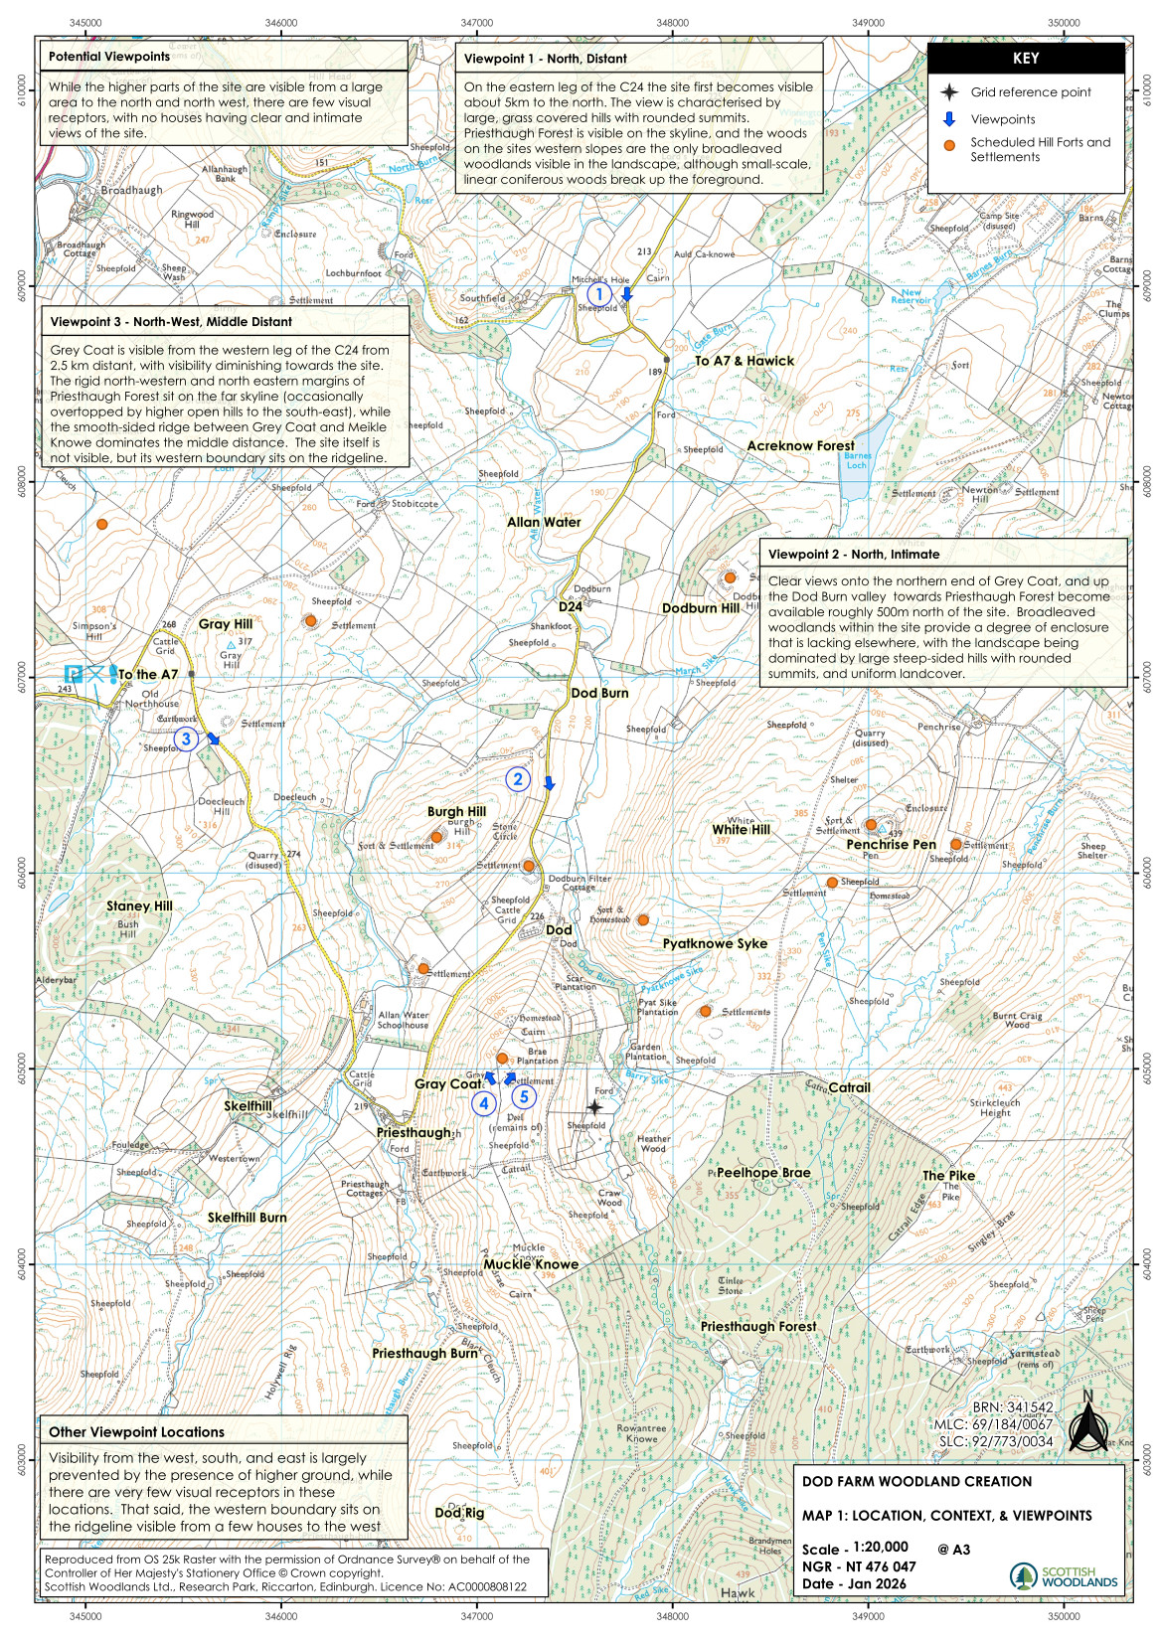
3

Slide 4
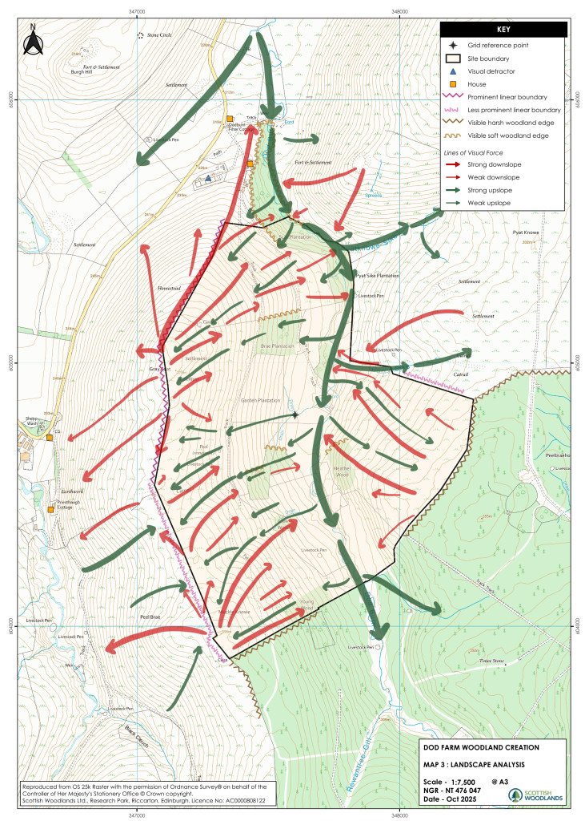

Slide 5
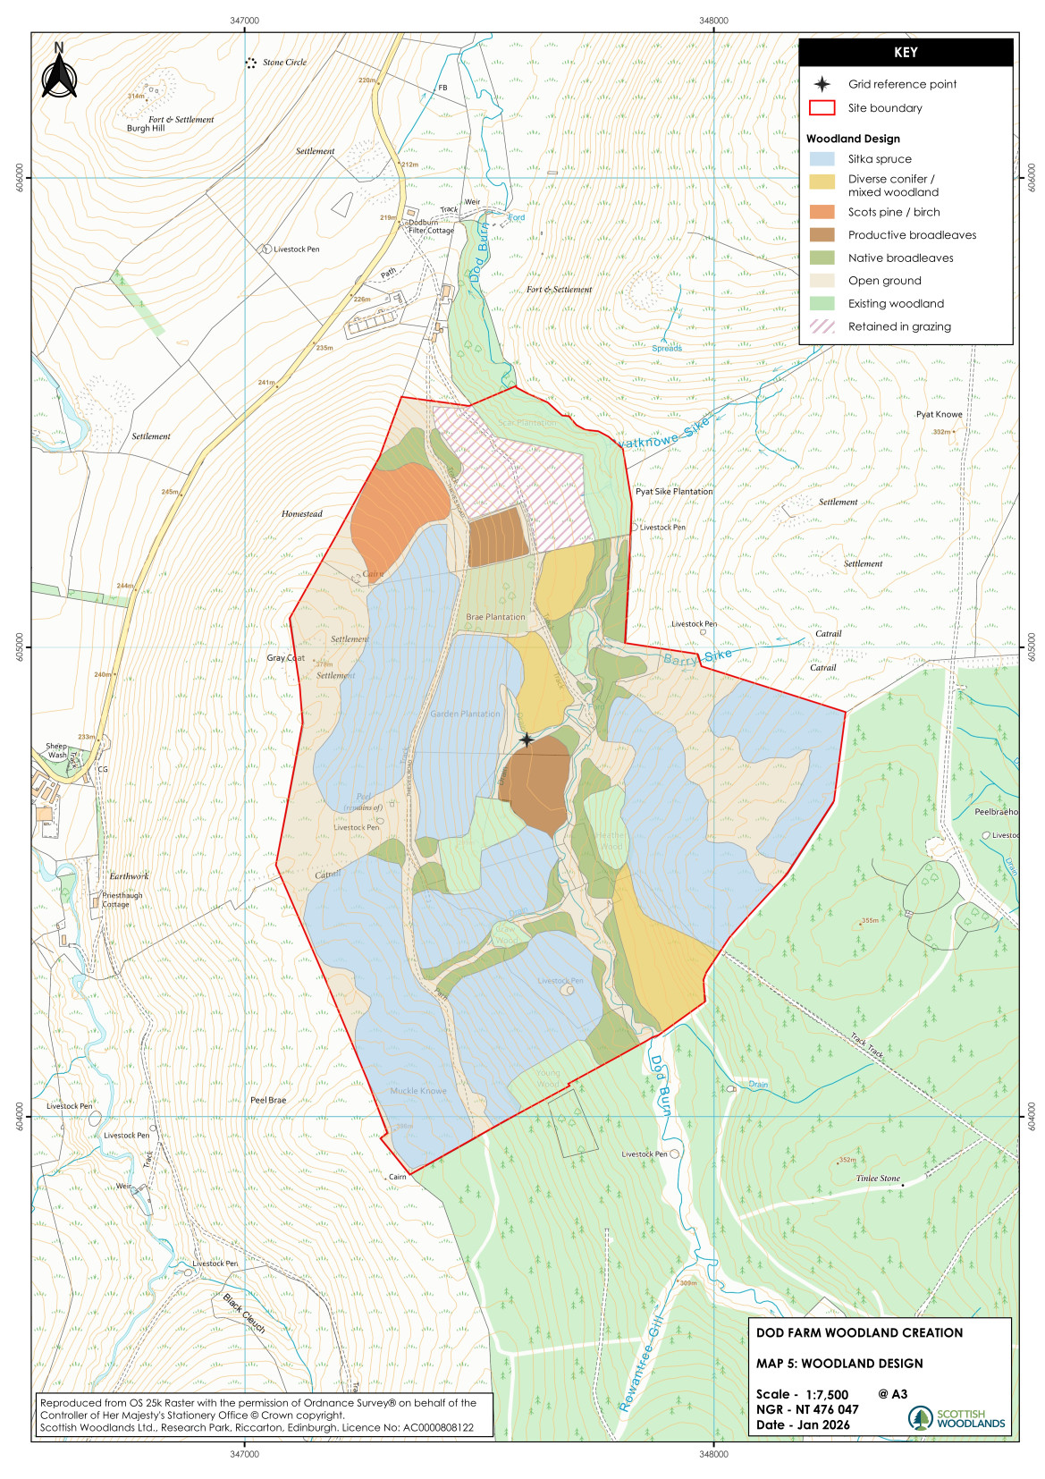

Slide 6
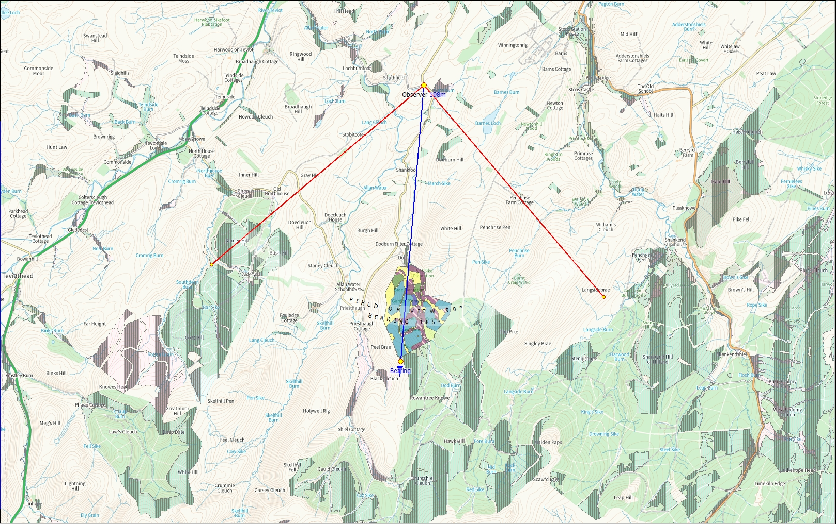
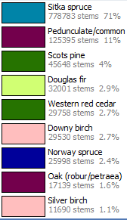
Viewpoint 1

Slide 7
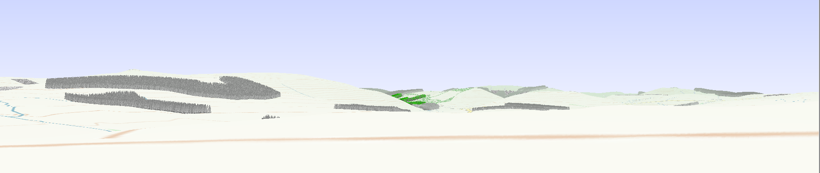
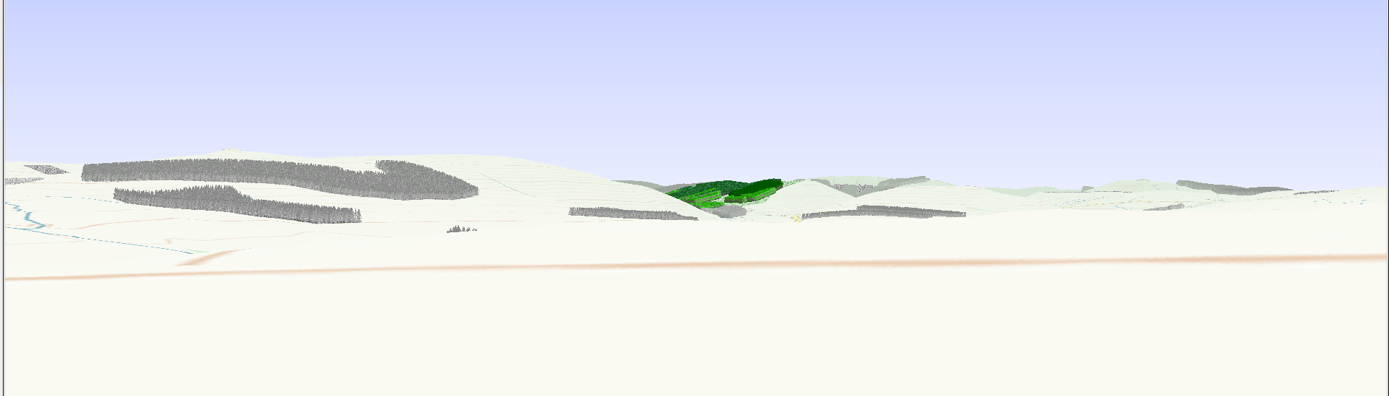
Viewpoint 1 – From D 24 Road – Distant View
2026
On the eastern leg of the C 24 the site first becomes visible about 5km to the north. The view is characterised by large, grass covered hills with rounded summits. Priesthaugh Forest is visible on the skyline above Grey Coat, and the woods on the site’s western slopes (shown in green) are the only broadleaved woodlands visible in the landscape, although small-scale, linear coniferous woods break up the foreground.
2066
The proposed planting will clothe the eastern slopes of Dod Hill, but the retention of open ground around the Scheduled Monuments will prevent the occurrence of harsh lines on the prominent hill top, as well as retaining intervisibility between Scheduled Monuments. The use of broadleaved and Scots pine mixes on the visible northern margin will create a soft and attractive woodland edge, tying into the existing woods.

Slide 8
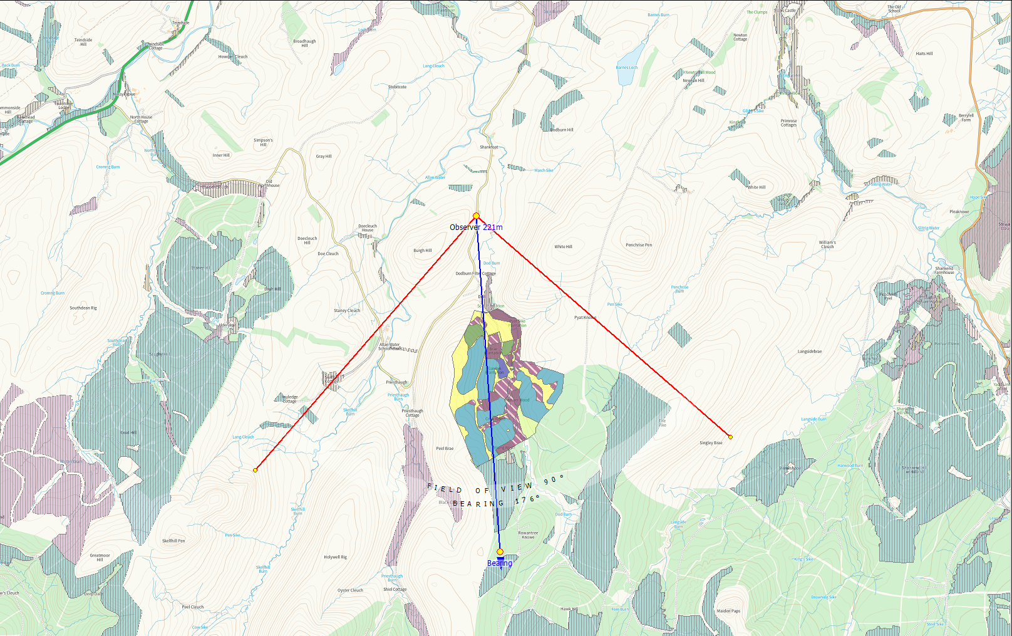
Viewpoint 2

Slide 9
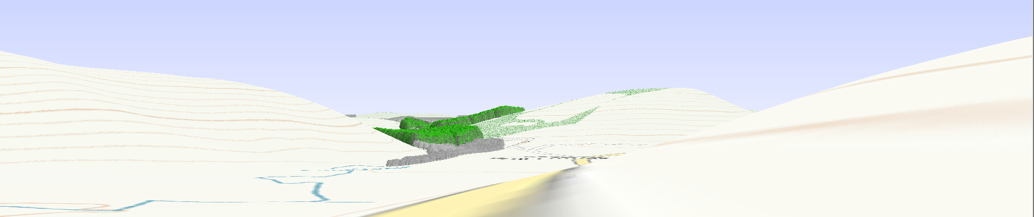
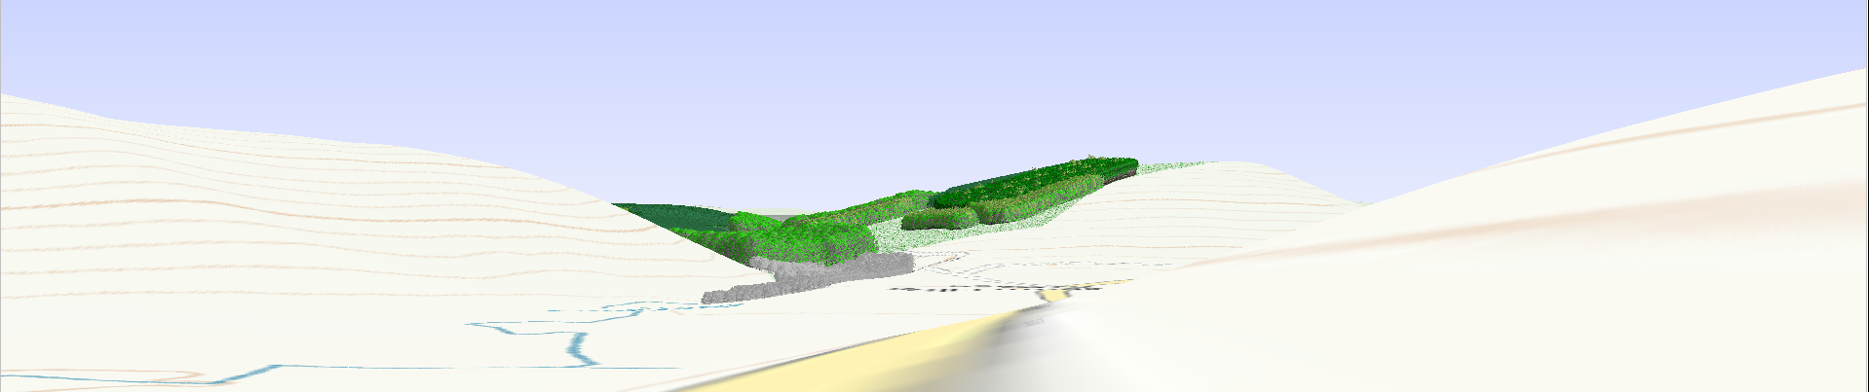
Viewpoint 2 – View from the D 24 road – Intimate View
2026
Clear views onto the northern end of Grey Coat, and up the Dod Burn valley towards the northern edge of Priesthaugh Forest, become available roughly 500 m north of the site. Existing broadleaved woodlands within the site provide a degree of enclosure that is lacking elsewhere in the landscape, with the landscape being dominated by large steep-sided hills with rounded summits, and uniform landcover.
2066
As with view 1, the woodland will fill the valley sides above the Dod Burn, but will be held back from the more visible ridgeline of Grey Coat. The existing broadleaved woodland by the Burn will be bolstered by further broadleaved planting, while the open ground above the steading will break up the woodland mass.

Slide 10
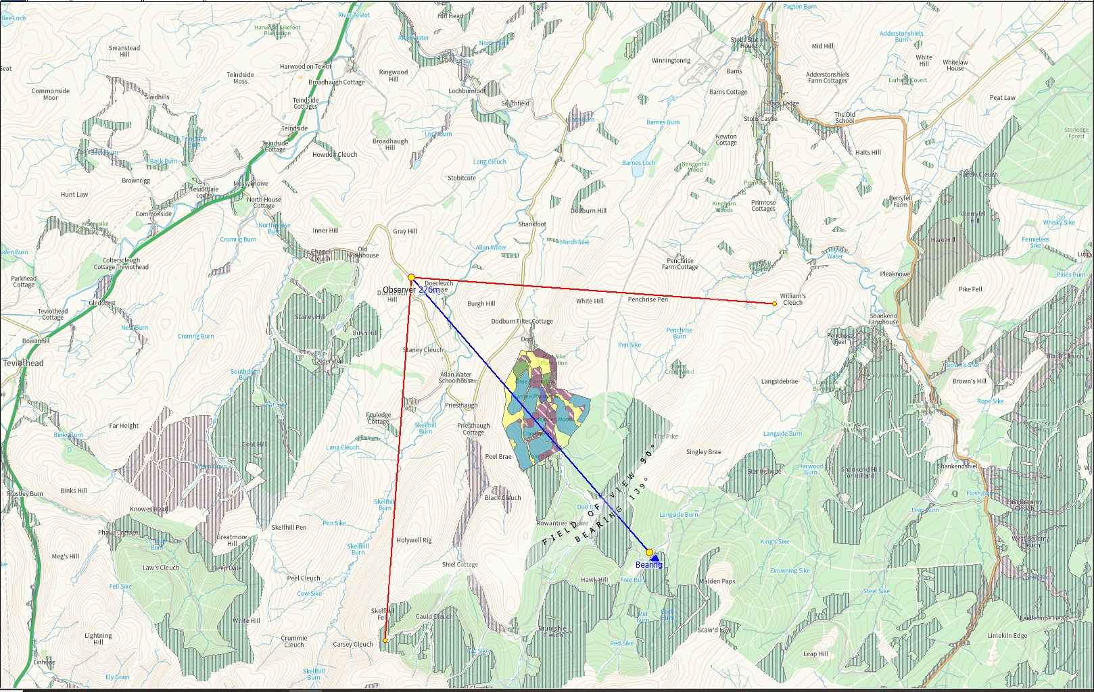
Viewpoint 3

Slide 11
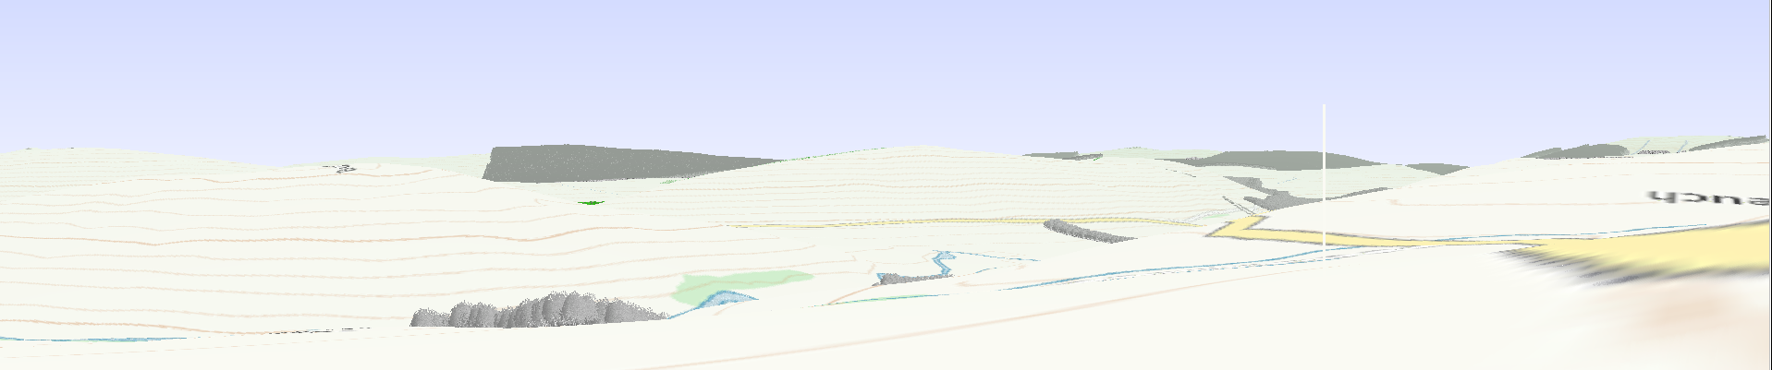
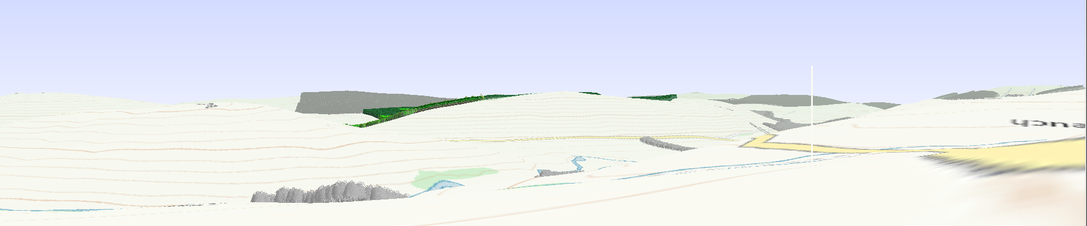
Viewpoint 3 –Western leg of D 24 road
2026
Grey Coat is visible from the western leg of the C24 from 2.5 km distant, with visibility diminishing towards the site. The rigid north-western and north eastern margins of Priesthaugh Forest sit on the far skyline (occasionally overtopped by higher open hills to the south-east), while the smooth-sided ridge between Grey Coat and Meikle Knowe dominates the middle distance. The site itself is not visible, but its western boundary sits on the ridgeline. The abrupt woodland edge on Peelhope Brae is also visible on the eastern side of the Dod Burn valley.
2066
The upper woodland edge will in time become visible from a short stretch of the road, but the ridgeline summit on Grey Coat will remain open. Further south, the woodland will tie into Priesthaugh Foresty both on Muckle Knowe, and on the far side of the Dod Burn valley, where the woodland will also lower the existing woodland edge on Peelhope Brae.

Slide 12
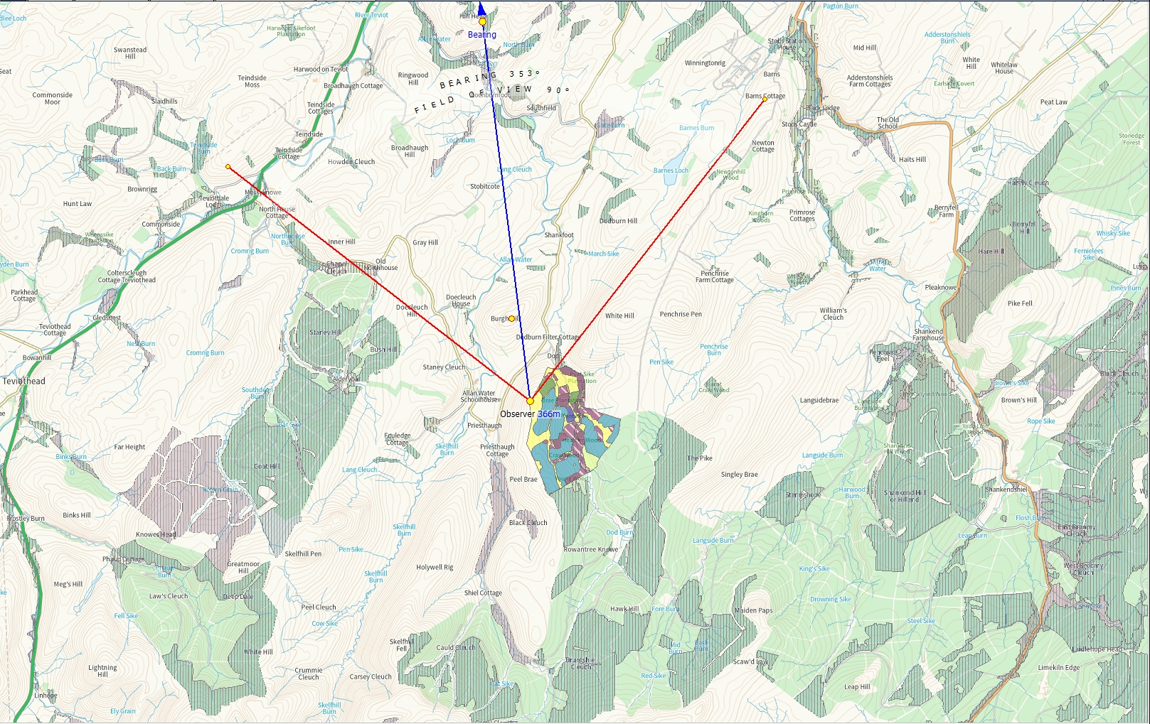
Viewpoint 4

Slide 13
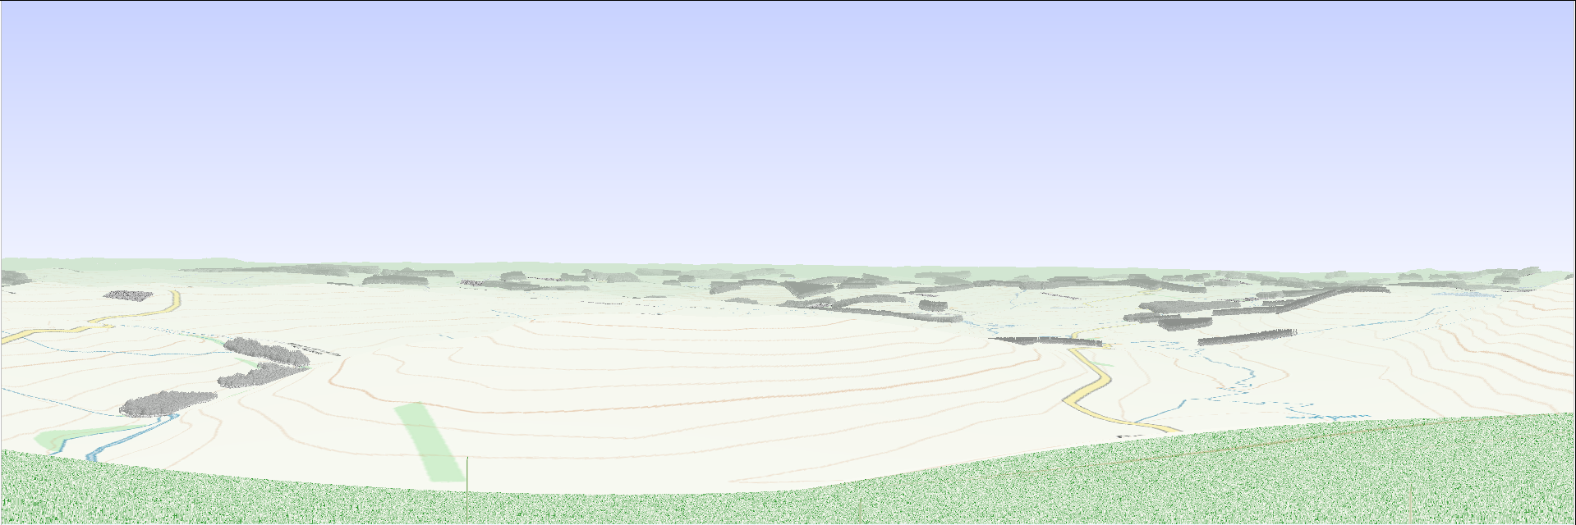
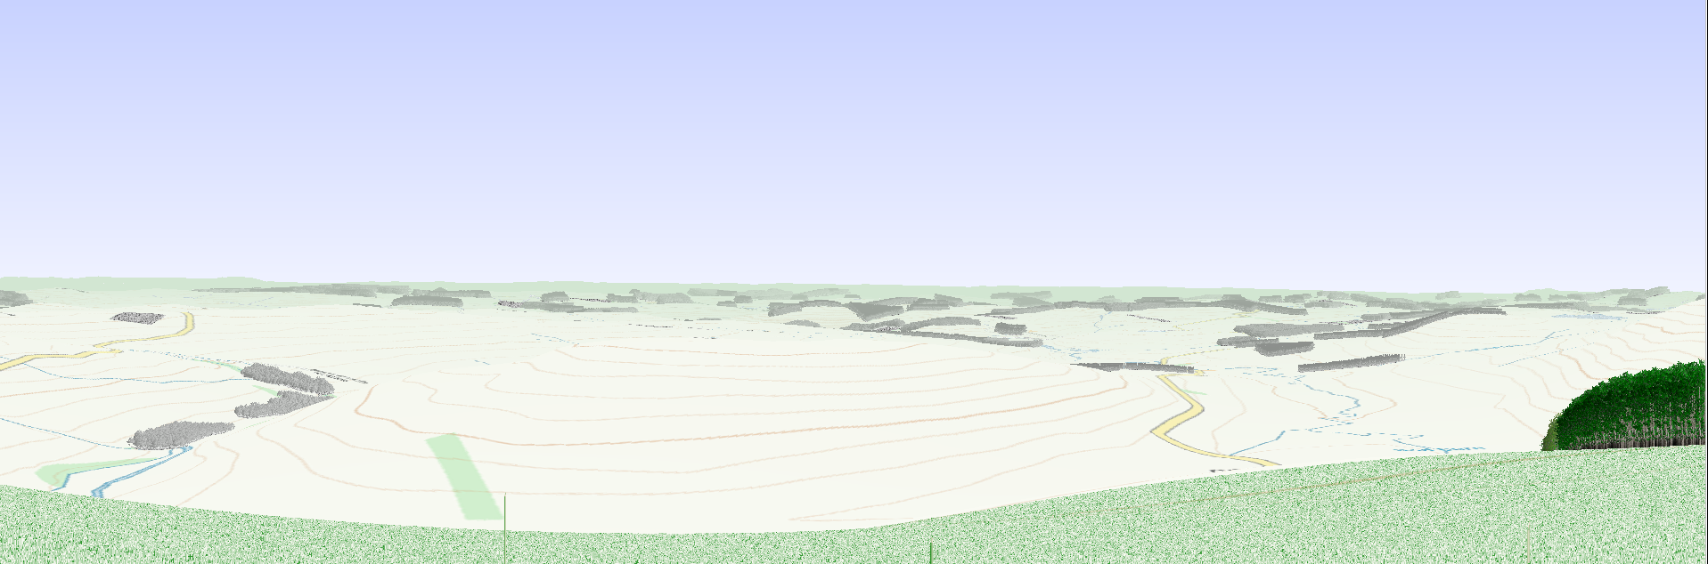
Viewpoint 4 - View north from Grey Coat Scheduled Monument
Burgh Hill
Dod Burn Settlement
Dod Burn Hill
2026
Looking due north from the hill fort on Gray Coat; the hill forts at Burgh Hill and Dodburn Hill, and the settlements by the Dod Burn are all clearly visible from what is an elevated position.
Burgh Hill
Dod Burn Settlement
Dod Burn Hill
2066
The woodland planting will be held back for a height of 30 m from the summit, and there will be no impact on intervisibility.
/

Slide 14

Viewpoint 5

Slide 15
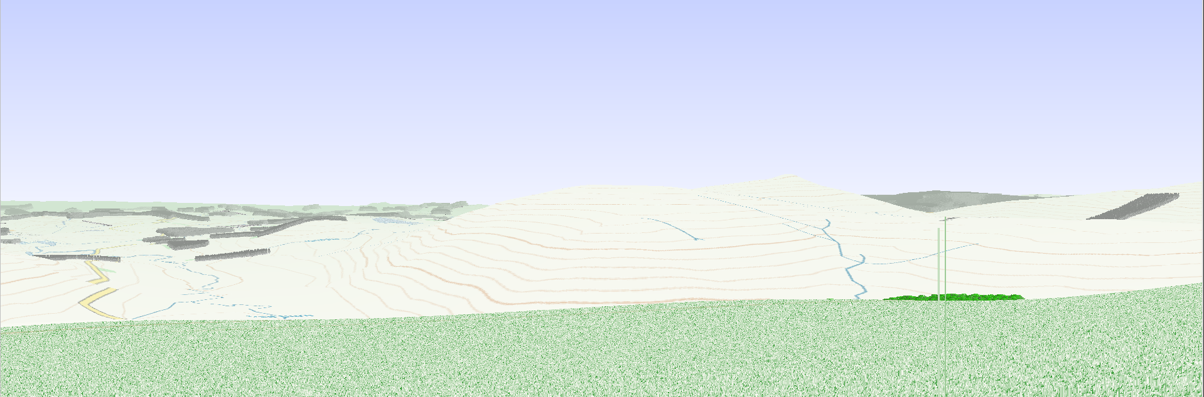
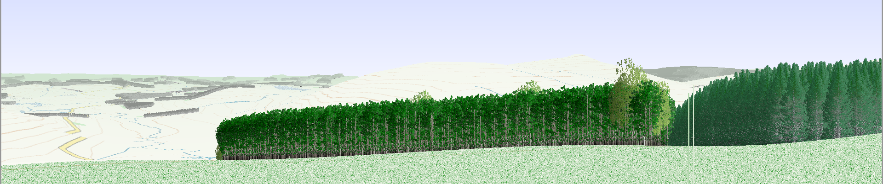
Viewpoint 5 -View north-eastwards from Grey Coat Scheduled Monument
Dod Burn
Pyat Knowe
Penchrise Pen
2026
Looking north-eastwards from the hill fort on Gray Coat; the hill forts at Dodburn Hill, Pyat Knowe and Penchrise Pen are all clearly visible from what is an elevated position.
Dod Burn
Pyat Knowe
Penchrise Pen
2066
The planting will be held back roughly 125 m distance and 20 m in height from the fort. All of the mentioned monuments will remain visible in the middle distance, albeit that the upper woodland edge will be visible in the foreground. The use of pine, togetherwith groups of birch, will soften the woodland’s upper margin.

